Slide 1
Lesson 19 – Homework review

Slide 2
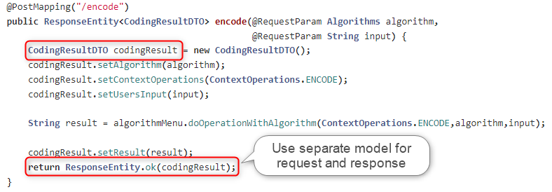
Follow Single Responsibility Principle

Slide 3
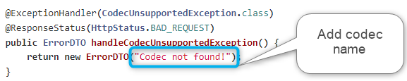
Add more details to errors

Slide 4
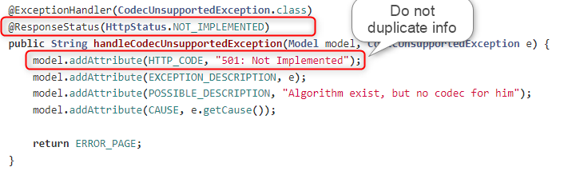
Do not Repeat Yourself

Slide 5
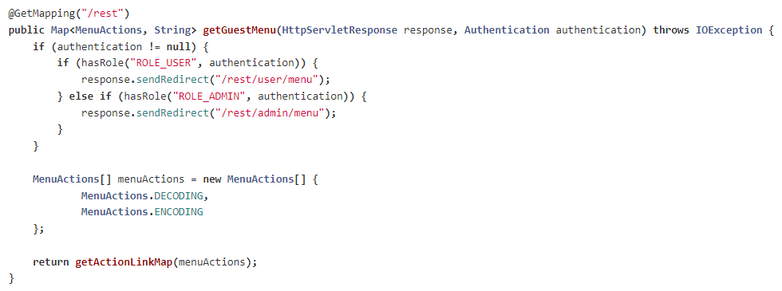
Operate on resource, nor html nor redirect

Slide 6
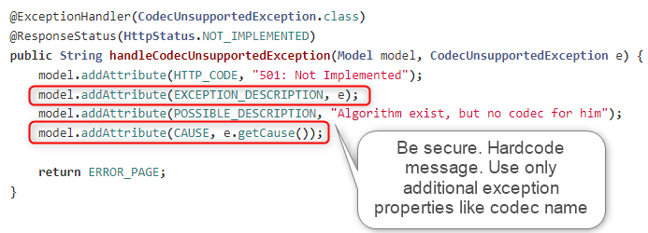
Do not expose server details

Slide 7
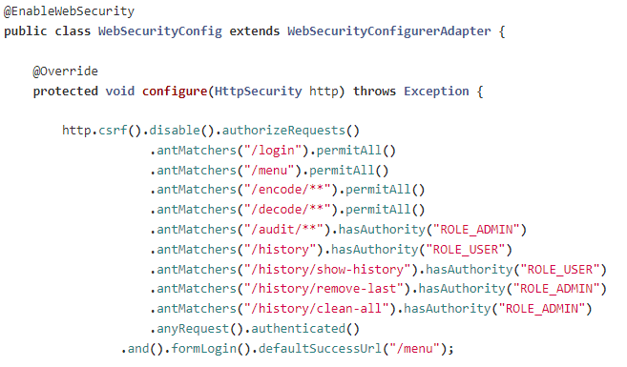
Secure REST API

Slide 8
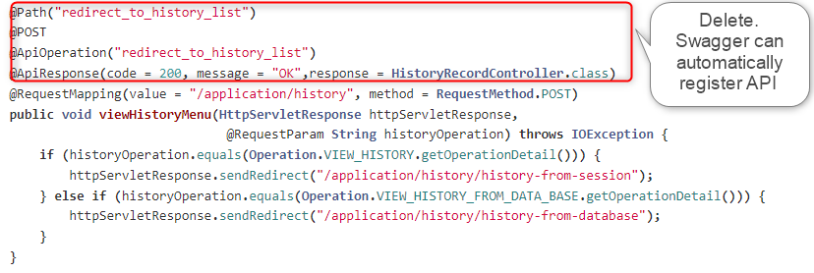
Do not couple code

Slide 9
Apply recommendations from personal feedbacks before starting next homework

